Slide 1
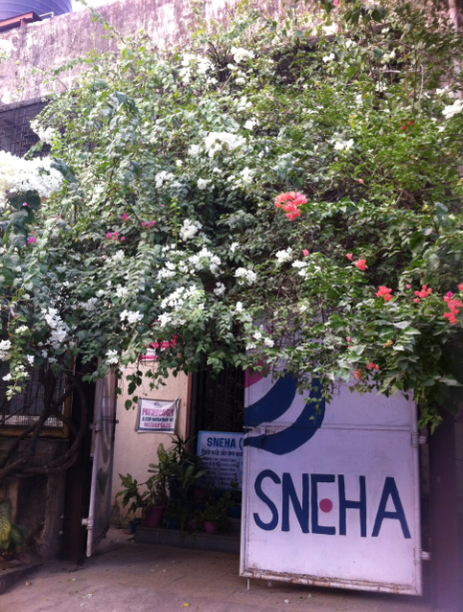
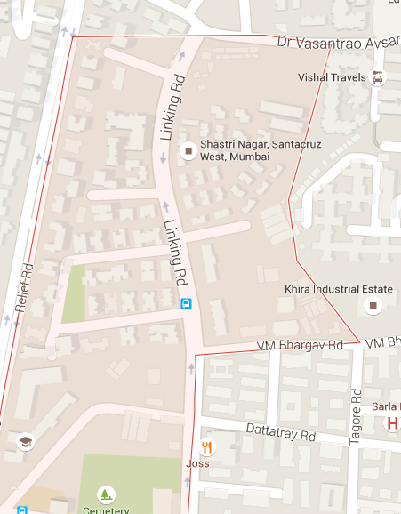
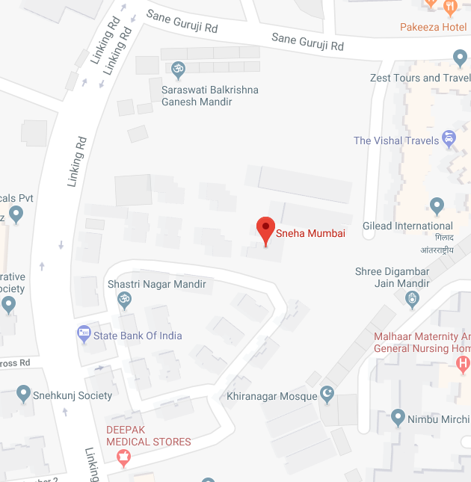
SNEHA Behind Bldg. No. 11, BMC Colony Shastri Nagar, Santa Cruz (W), Mumbai - 400 054, INDIA
https://www.google.co.uk/maps/place/Sneha+Mumbai/@19.088882,72.8349817,18.5z/data=!4m5!3m4!1s0x3be7c9a46a721f1f:0x679c8f290fd7bde3!8m2!3d19.0886811!4d72.8353377
Directions:
Our building is at the top end of Link Road. Heading north, take a right into the BMC Colony (c 300 m beyond the BMW garage and Joss Restaurant). Follow the road/path for c 70 m and you will see the SNEHA white gate with the SNEHA logo under a bush (see picture).
SNEHA
BMW Garage & Joss Restaurant

